Slide 1
Machine Learning - Hardware Acceleration Efficiency and Performance Comparison
Analysis of Anders Embedded platforms and
3rd-Party accelerators

Slide 2
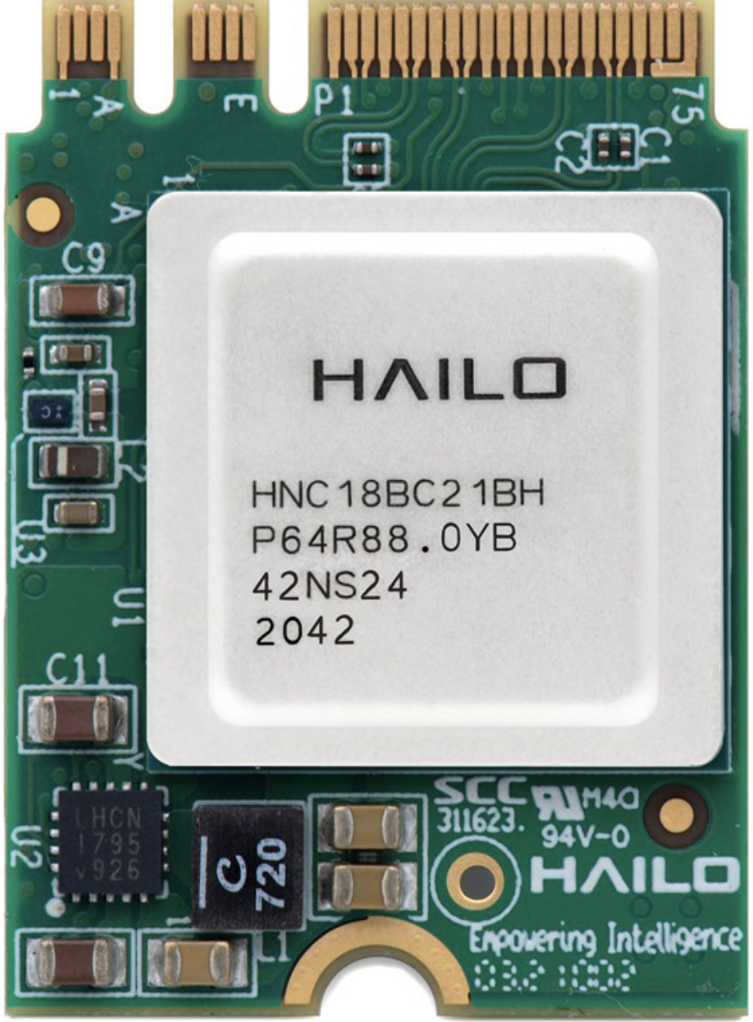
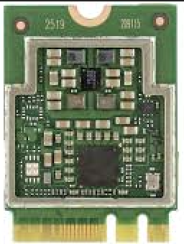
Introduction
Overview of YOLOv5s Model:
YOLOv5s: a popular deep learning (pre-trained) model for object detection.
Applications in various computer vision tasks such as real-time object tracking and image analysis.
Importance of Hardware Configuration:
Hardware significantly impacts the performance and efficiency of deep learning models.
The need to compare different hardware setups to determine optimal configurations.
Tested Hardware Configurations:
CPU: General-purpose processors without dedicated AI acceleration.
ARM and x86 Systems: Different architectures used in various embedded and edge devices.
AI Accelerators: Specialized hardware (Coral TPU, Hailo-8, onboard NPU) designed to accelerate AI inference.

Slide 3
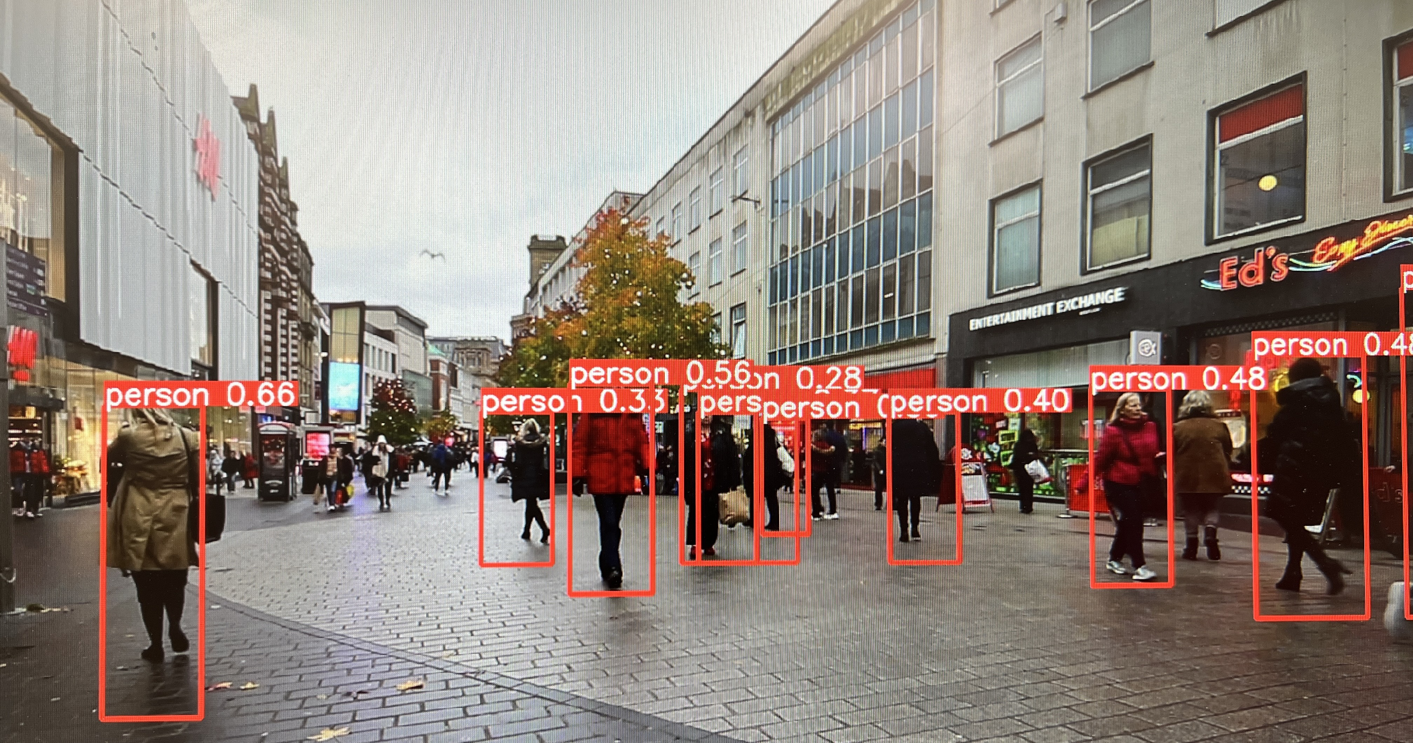
Objective
Primary Goal:
Provide insights into the most effective and efficient hardware configurations for deploying the YOLOv5s model in real-world applications
Key Metrics:
Evaluate Inference Speed:
Measure and compare the time taken for inference.
Assess Average FPS:
Highlight which setups meet or exceed the 30 FPS for real time detection.
Analyse Power Consumption:
Compare power consumption.
Discuss the energy efficiency and potential cost implications of each setup.
Examine Running Temperature:
Measure operating temperature of CPU and AI accelerators.
Identify potential cooling requirement
Costs

Slide 4
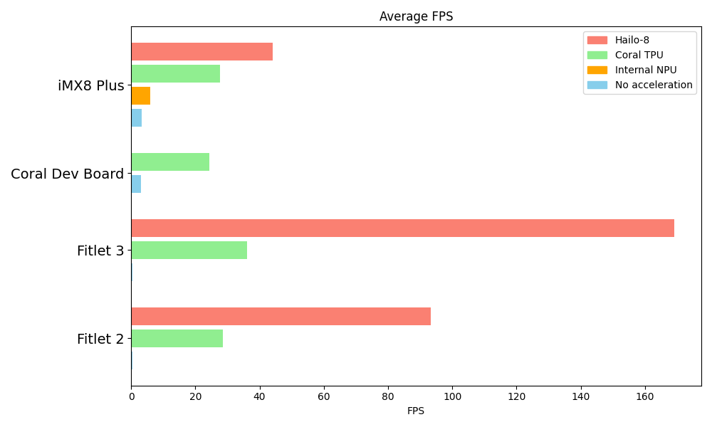
Average FPS
Internal NPU 2x faster than CPU
Coral TPU 10x faster than CPU
Hailo-8 at least 2x faster than Coral TPU(ARM)

Slide 5
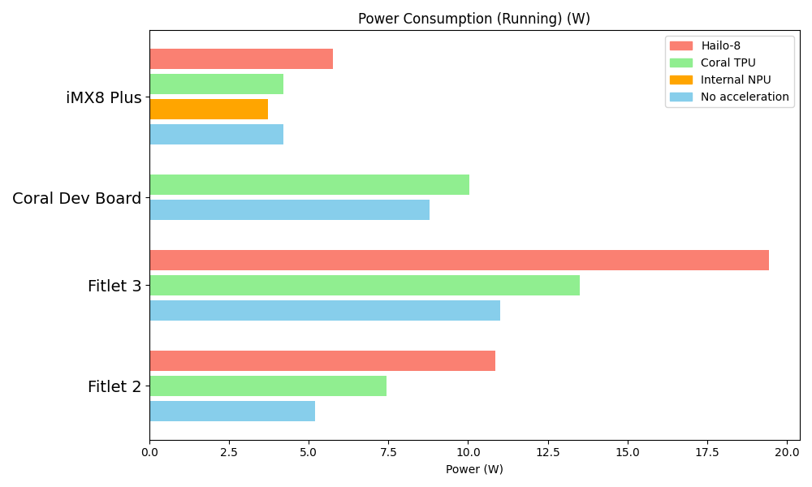
Power Consumption
Internal NPU doesn't increase power
Coral TPU 1.1x power consumption than CPU
Hailo-8 1.4x power consumption than Coral TPU

Slide 6
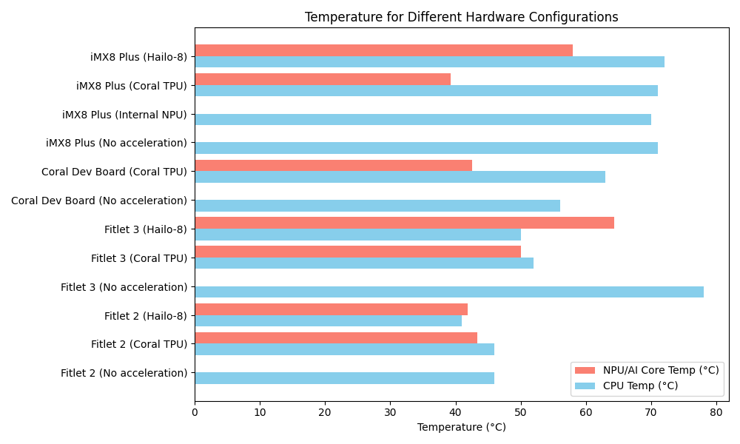
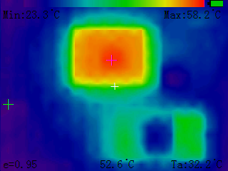
Running temperature
External accelerators double the amount of heat generated but do not increase the overall temperature. Instead, they distribute the heat more evenly.
NPU doesn't increase CPU temperature.

Slide 7
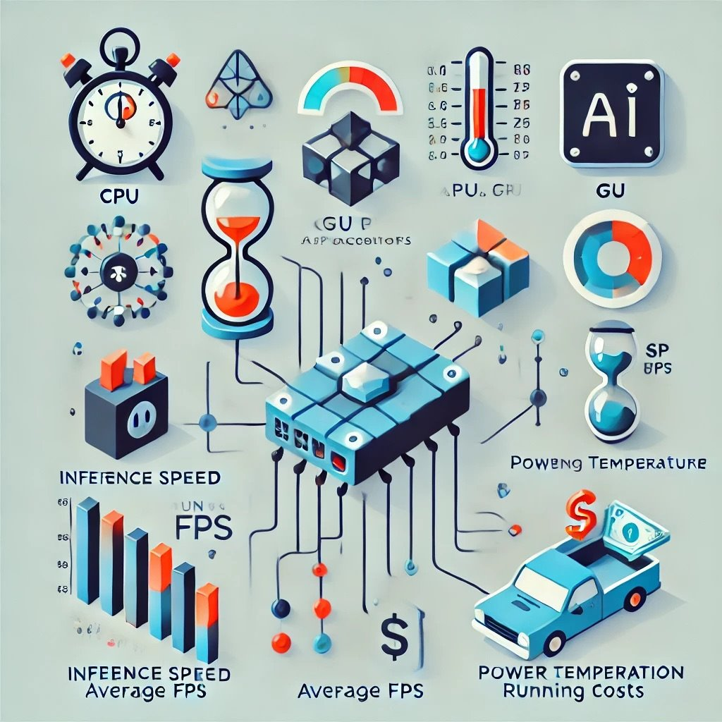
Key Findings
Inference Speed:
Fastest: Hailo-8
Average FPS:
Real-time Processing: Both Coral TPU and Hailo-8.
Power Consumption:
Lowest Consumption: iMX8 Plus with Internal NPU or CPU.
Power Efficiency: Coral TPU
Running Temperature:
Thermal Efficiency: Coral TPU
Cost:
NPU: No extra cost
Coral TPU: +$25
Hailo-8: +$175

Slide 8
Summary
Arm-based CPUs demonstrated higher power efficiency and computational power compared to x86 systems.
Coral TPU enabled real-time detections, achieving FPS rates exceeding the 30 FPS threshold.
Hailo-8 provides highest computation power that can process multiple video streams simultaneously in real-time
NPUs delivered enhanced performance without a substantial increase in energy usage
Coral TPU is more power-efficient compared to Hailo-8, offering a better balance of power consumption and FPS improvements
Coral TPU is more cost-effective compared to the higher-priced Hailo-8

